Slide 1
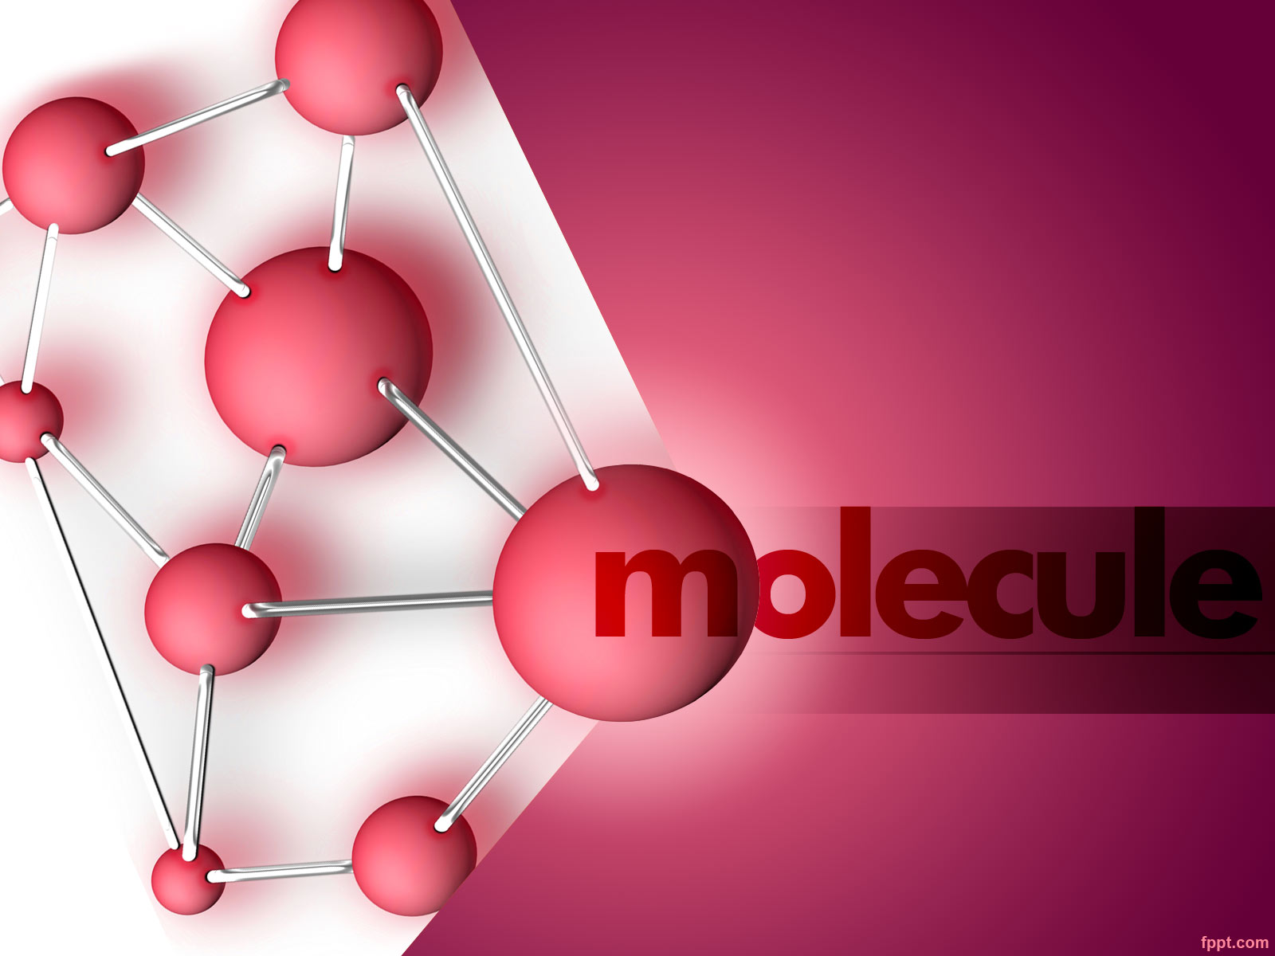

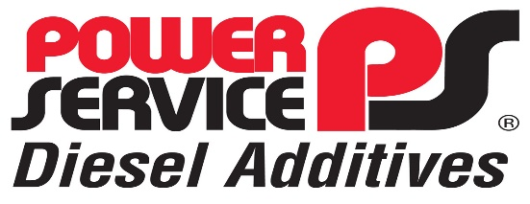

Daniel Chevin

Slide 2

power Service
Family business established 1956
ONLY manufacture diesel additives
60% of USA diesel additive market closest competitor has 14%
Developed Cummins partnership in 2017 after 3 yrs of testing
Manufacture most technologically advanced diesel additives
4.9 million liter bulk chemical storage plant
Over 1000 distributors and retail outlets in USA
State of the art research laboratories in Weatherford Texas
https://witherspoon.app.box.com/s/7egl6spx41mkw3hdmkz2tymdahbq7qe1/file/783216823602

Slide 3

Power Service Markets
Truck & Bus
Earthmoving
Agriculture
Marine
Generators
Auto industry

Slide 4
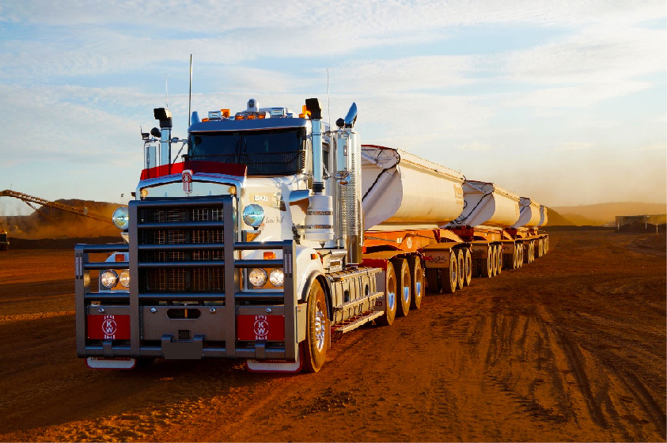
Power Service power Service

Slide 5

power Service
https://www.marship.eu/why-diesel-fuel-is-drying-out

Slide 6

Power Service power Service

Slide 7

Power Service power Service

Slide 8

Markets
Marine
.

Slide 9
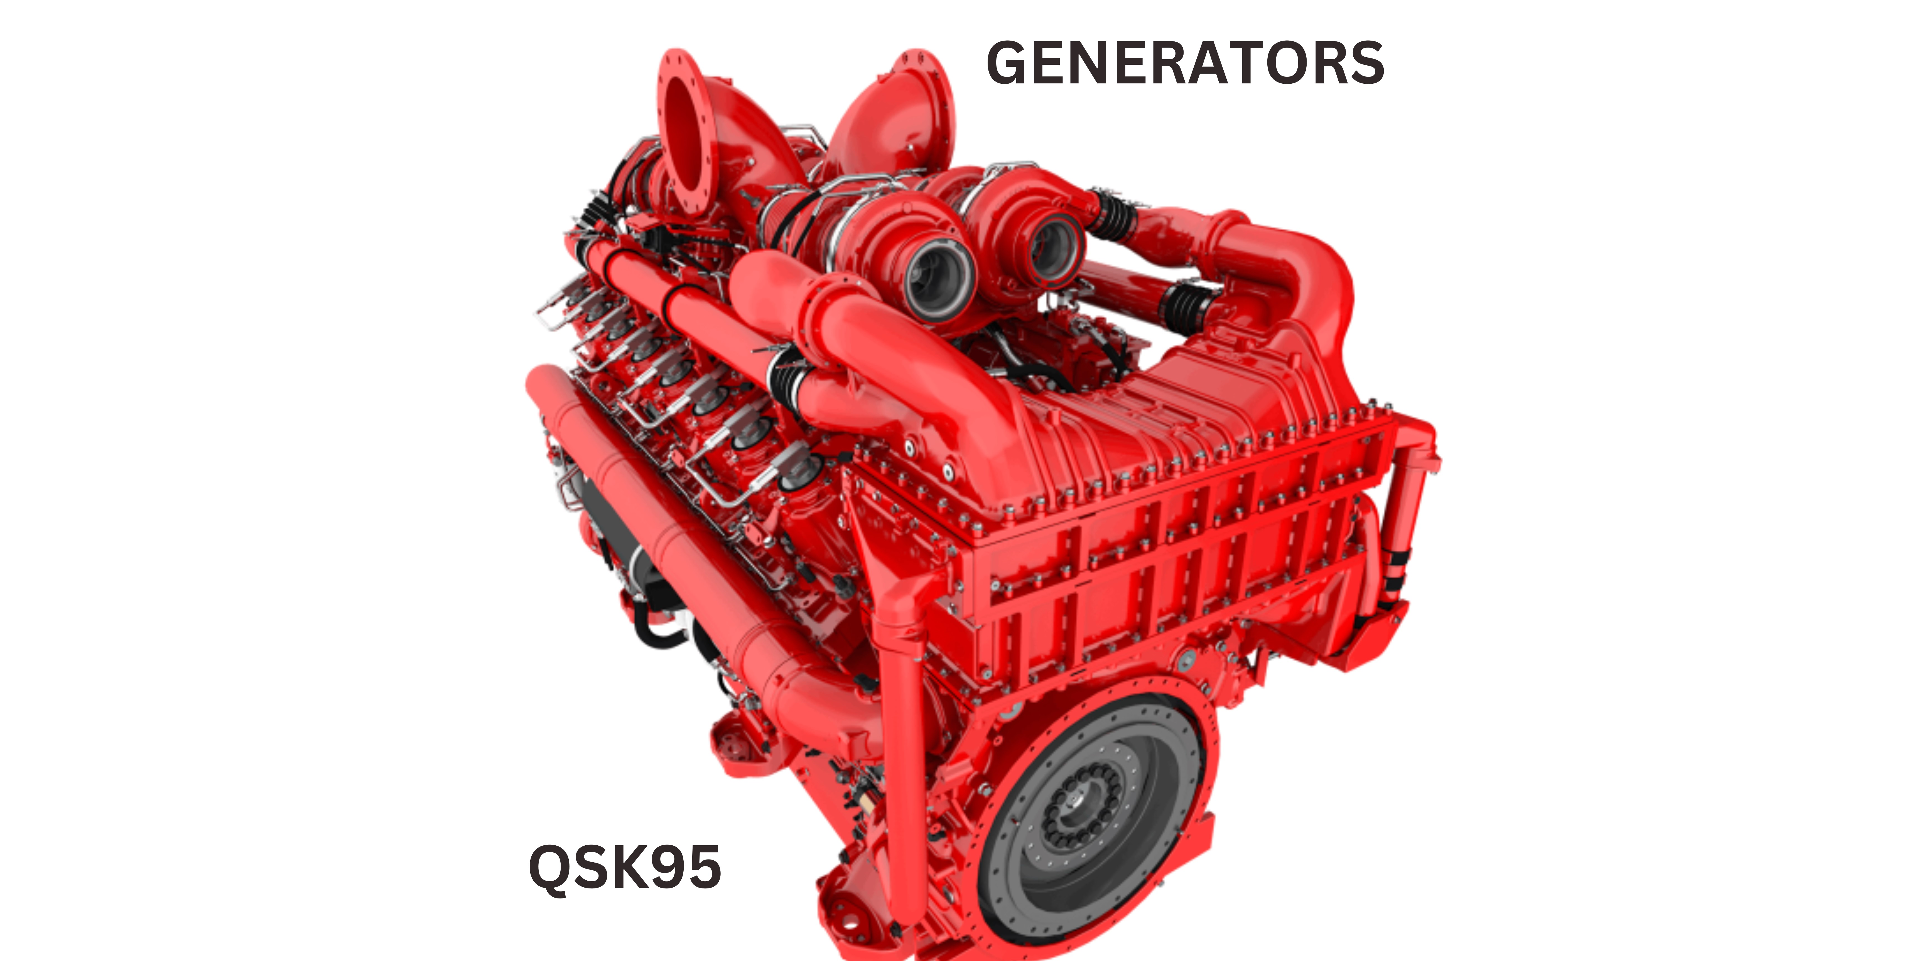
power Service

Slide 10

.

Slide 11
Why diesel fuel is drying out
.
https://www.marship.eu/why-diesel-fuel-is-drying-out

Slide 12
Composition of Diesel
It's important to note that the exact composition of diesel fuel can vary between different regions and fuel suppliers
Diesel fuels are complex hydrocarbon mixtures, containing all the classes of hydrocarbons:
Paraffins,
Naphthenes,
Aromatics,
Olefins.

Slide 13
Composition of diesel fuel
1. Hydrocarbons: Diesel fuel primarily consists of hydrocarbon compounds, which are organic compounds composed of hydrogen and carbon atoms. These hydrocarbons provide the energy when diesel fuel is burned.
2. Alkanes: Alkanes, also known as paraffins, are a type of hydrocarbon found in diesel fuel. They are straight-chain or branched-chain molecules that provide energy during combustion.
3. Aromatics: Aromatics are a class of hydrocarbons that contain a ring structure. These compounds, such as benzene, toluene, and xylene, are present in small amounts in diesel fuel and contribute to the fuel's energy content.
4. Cycloalkanes: Cycloalkanes are hydrocarbons that form a ring structure. They are present in diesel fuel in small amounts and contribute to the overall energy density.

Slide 14
Composition of diesel fuel
5. Sulphur: Historically, diesel fuel contained significant amounts of sulphur. However, in many regions, regulations have mandated the reduction of sulphur content in diesel fuel to reduce emissions. Ultra-low sulphur diesel (ULSD) is now the standard in many countries, with sulphur content typically limited to 15 parts per million (ppm) or lower.
6. Additives: Diesel fuel may also contain additives to improve its performance and address specific requirements. These additives can include cetane improvers, detergents, lubricity enhancers, anti-foaming agents, and corrosion inhibitors, among others.
It's important to note that the exact composition of diesel fuel can vary between different regions and fuel suppliers, as they may have different refining processes and blend additives to meet specific requirements and regulations.

Slide 15
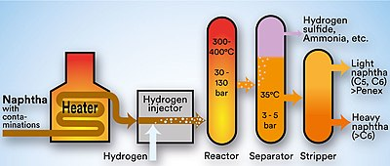
Desulphurization process
.

Slide 16
What are diesel additives
Diesel fuel additives are added to improve its performance and address specific requirements. These additives include
Cetane improvers,
Detergents,
Lubricity enhancers,
Anti-oxidants
Corrosion inhibitors,
Emulsifiers

Slide 17
Benefits of Fuel Additives
Stabilize fuel hydrocarbons
Clean piping systems & protects filters clogging. Clean combustion chambers creating unobstructive airflow for combustion
Lubricity protecting surfaces against wear in the pump and injectors
Cetane improver improves combustion efficiency increasing the Cetane number by up to 6 points and decreases fuel consumption
Exclusive Deposit Control Technology in the fuel system protects injectors & nozzle carbon buildup enhancing atomization of fuel droplets increasing fuel combustion efficiency by reducing surface tension on the droplets.
Resulting in Extensive reduction in maintenance costs , parts & servicing/ calibration
Significantly Increases productivity, reduces downtime & labour costs
Lessens emissions of NOx & other particulates due to a more efficient combustion

Slide 18
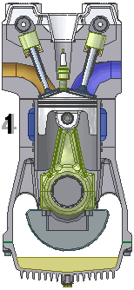
How additives improve engine performance
Increased lubricity preventing engine component wear due to ULSD Polynuclear Aromatic compound extraction during de-sulphurization.
Cetane improver improves the Cetane number by up to 6 points creating a more efficient combustion less emissions more power.
Corrosion inhibitors preventing corrosion of tanks and fuel system, parts and piping.
Patented Deposit Control Technology preventing injectors sticking and malfunctioning decreasing downtime, increasing productivity with less emissions & black smoke .

Slide 19
Cetane improvers
These compounds help to improve the ignition quality of the fuel, leading to better combustion and improved engine performance
1. 2-Ethylhexyl nitrate (2-EHN): This is one of the most commonly used cetane improvers. It is a liquid that is added to diesel fuel in small amounts to improve its ignition quality.
2. Di-tert-butyl peroxide (DTBP): This is another commonly used cetane improver. It is a liquid that is added to diesel fuel in small amounts to improve its ignition quality.
3. Ethylhexyl nitrate (EHN): This is a similar compound to 2-EHN, but it is less commonly used as a cetane improver.
4. Peroxides: Some peroxides, such as cumene hydroperoxide, can also be used as cetane improvers

Slide 20
Detergents additives
These compounds help to clean the fuel system and prevent the buildup of deposits and contaminants: Clean fuel injectors, prevent carbon deposits, and maintain engine cleanliness
This detergent is a low molecular weight polyisobutylene monosuccinimide of polyethylene polyamine in an aromatic hydrocarbon diluent.
Power Service Patented Detergent efficacy was proven in the Cummins N-14 test that measures change in the flow rate of a fluid through an injector orifice. Corrosion of the injector results in an increased flow rate. Addition of protective agents to the fluid may prevent or minimize the increase in flow rate through the orifice. Power Service detergents were proven here in prevent this from occuring

Slide 21
Anti Oxidants
Phenolic antioxidants: These are the most commonly used antioxidants in diesel fuel additives. They work by breaking the chain reaction of free radical formation and preventing the oxidation of the fuel.
2. Amine antioxidants: These are also commonly used in diesel fuel additives. They work by scavenging free radicals and preventing the oxidation of the fuel.
3. Sulphur-containing antioxidants: These are less commonly used in diesel fuel additives, but they can be effective in preventing the oxidation of the fuel.
4. Phosphorus-containing antioxidants: These are also less commonly used in diesel fuel additives, but they can be effective in preventing the oxidation of the fuel.

Slide 22
Corrosion inhibitors
1. Organic acids: These are commonly used in diesel fuel additives to prevent corrosion in fuel systems. They work by forming a protective layer on metal surfaces, preventing corrosion from occurring.
2. Amines: These are also commonly used in diesel fuel additives for their anti-corrosion properties. They work by neutralizing acids that can cause corrosion in fuel systems.
3. Phosphates: These are less commonly used in diesel fuel additives, but they can be effective in preventing corrosion in fuel systems.
4. Benzotriazole: This is a chemical that is sometimes used in diesel fuel additives for its anti-corrosion properties. It works by forming a protective layer on metal surfaces, preventing corrosion from occurring.

Slide 23
Emulsifiers
1. Surfactants - These are compounds that have both hydrophilic (water-loving) and hydrophobic (water-repelling) properties, allowing them to help mix oil and water.
2. Polysorbates - These are a type of surfactant that are commonly used in food and pharmaceutical applications.
3. Polyethylene glycols (PEGs) - These are water-soluble polymers that can help to stabilize emulsions.
4. Phospholipids - a type of lipid that can help to form stable emulsions.
5. Gum arabic - a natural emulsifier derived from the sap of the acacia tree.

Slide 24
What are Lubricity improvers
Lubricity improvers and friction modifiers
The diesel fuel fraction of crude oil contains sulphur and nitrogen compounds that provide natural lubrication to protect fuel pumps and injectors from wear. Fuel sulphur limits are becoming progressively more stringent and widespread, and the process of desulphurisation of diesel fuel removes these naturally occurring lubricating components ie PolyNuclear Aromatic Compounds from the diesel fuel. Many diesel fuel injection systems rely on this lubricity and the absence of such compounds will result in fuel that gives increased wear and eventual failure of critical fuel-delivery system components.

Slide 25
Lubricity improvers
1. Polyalphaolefins (PAOs): These are synthetic lubricants that are commonly used in diesel fuel additives. They provide excellent lubrication and can withstand high temperatures.
2. Polyisobutylene (PIB): This is a synthetic lubricant that is commonly used in diesel fuel additives. It provides good lubrication and can improve fuel efficiency.
3. Polyalkylene glycols (PAGs): These are synthetic lubricants that are commonly used in diesel fuel additives. They provide excellent lubrication and can improve fuel efficiency.
4. Mineral oils: These are natural lubricants that can be used in diesel fuel additives. They provide good lubrication but may not be as effective as synthetic lubricants.

Slide 26
Demulsifiers
1. Alcohols - These can help to break up emulsions by disrupting the hydrogen bonds between the water and oil molecules.
2. Organic acids - These can help to lower the pH of the emulsion, causing the oil and water to separate.
3. Salts - These can help to destabilize the emulsion by increasing the ionic strength of the solution.
4. Polymers - These can help to coagulate the emulsion particles, making them easier

Slide 27











Additive manufacturers

Slide 28
The fuel injection system
Tank
Filters
Fuel pump
Fuel piping
Injectors
Combustion chamber
Exhaust gases system

Slide 29
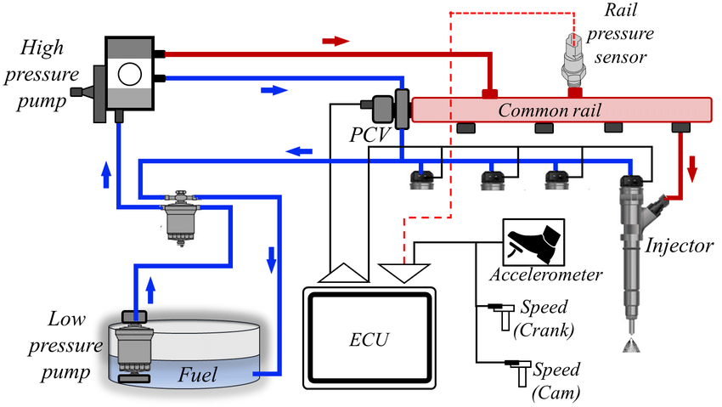
Common rail system
.

Slide 30
Tank problems
Bacteria & fungus build up –
blocked filters
Microbes –
create growth network & excrete acid causing corrosion
Corrosion –
WILL occur if bacteria & microbes are not treated
Water –
creates corrosion & interferes with injection & combustion process

Slide 31
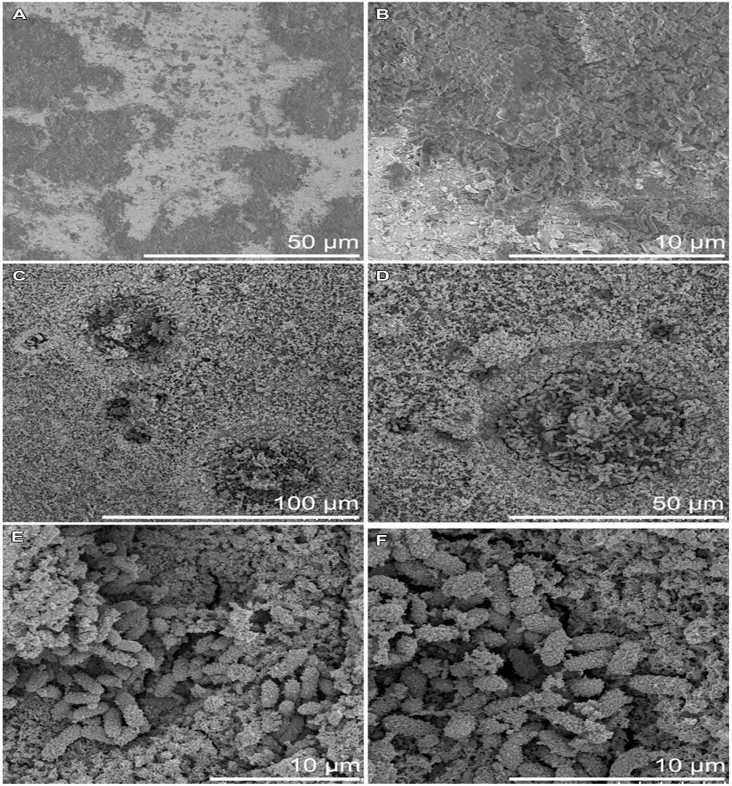
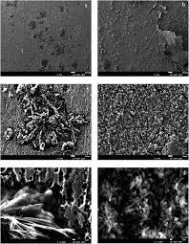
Microbial induced corrosion
.

Slide 32
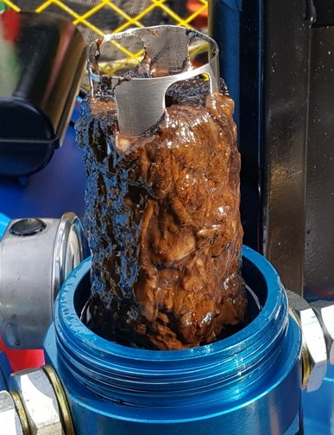
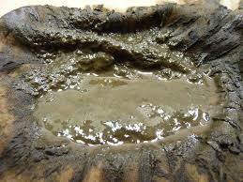
Diesel bug (Microbes)
.

Slide 33
Filters issues
Ashphaltenes & Monoglycerides
Black fine particles that clog filters & get into injectors
Wax build up
Due to low temperatures paraffin that is present in the fuel precipitates from the fuel and converts into a crystalline wax mass causing filter blockages
Bacteria & fungus
made up of microbial growth (sludge) that multiplies 2 x every 18 hours excreting waste before dying & repeats the process building up (Diesel Bug)

Slide 34
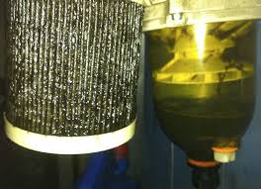
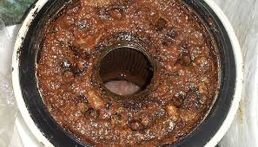
Microbial infestation
.

Slide 35
Fuel pump failures
Carbon deposit build up
Causing pressure drop due to restriction of flow originating from contamination in the tanks.
Wear
Excessive wear due to lack of lubricity of the diesel originating at sulphur extraction process in the refinery, bad fuel , dirt & moisture.
Insufficient filtration
Allowing particles of carbon and dirt to infiltrate the fuel system causing blockages and wear.

Slide 36
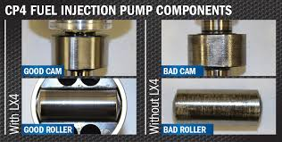
Fuel pump failures
.

Slide 37
Fuel injector problems
IDID ( internal diesel Injector Deposits)
Due to fine tolerances in the manufacture of high pressure (up to 30,000 PSI) in common rail systems injectors microscopic carbon deposits cause injector malfunctions or needle sticking. A specific deposit control formulation is required to keep this problem at bay.
Lack of lubricity
in the diesel fuel causes excessive wear on all the injector moving parts eventually causing injector replacements earlier than anticipated.
Carbon buildup
on the nozzle tips creating poor droplet atomization hence poor combustion & unburnt fuel
Costs factors
Downtime & labour costs, loss of production , recalibration & replacement costs

Slide 38
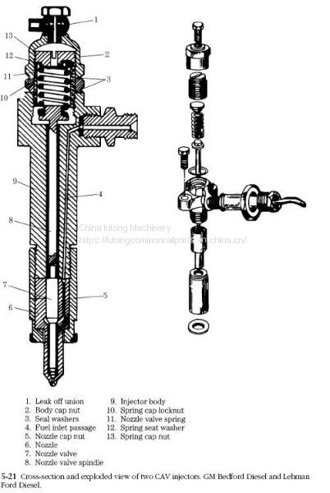
.

Slide 39
Before & After using Diesel Kleen

Slide 40
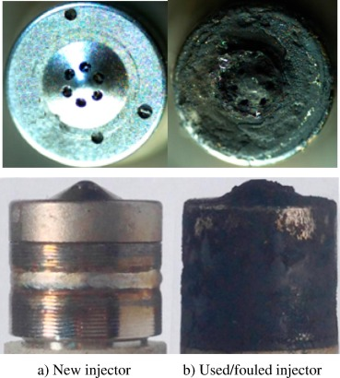
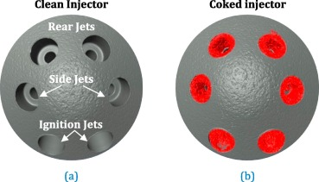
.

Slide 41
Combustion chamber problems
Airflow restrictions due to carbon buildup cause turbulence. That turbulence causes the air and fuel to mix unevenly. Which means areas of rich and lean mixtures creating hotspots in the combustion chamber which can result in pre ignition.
Inefficient combustion & loss of power due to unburnt fuel droplets causing increased carbon buildup & increased emissions
Injector atomization restrictions due to carbon buildup on injector nozzles

Slide 42
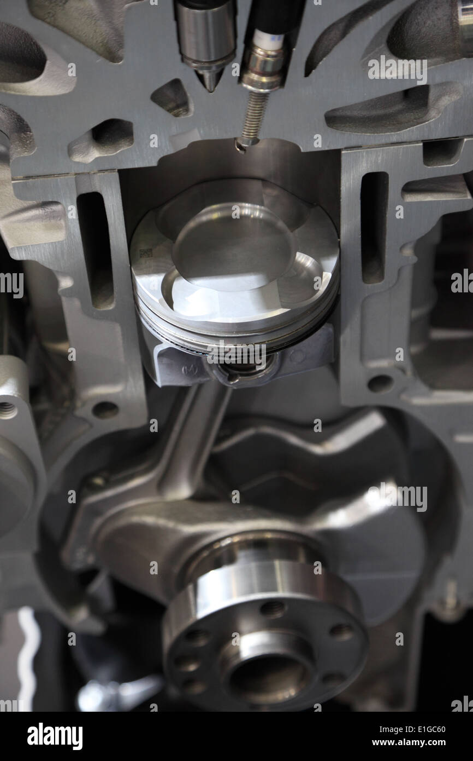
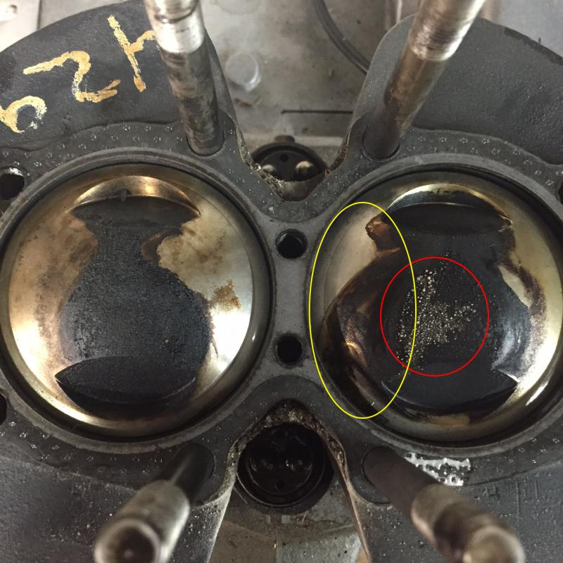
Combustion chamber

Slide 43
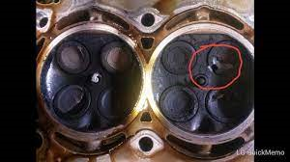
.

Slide 44
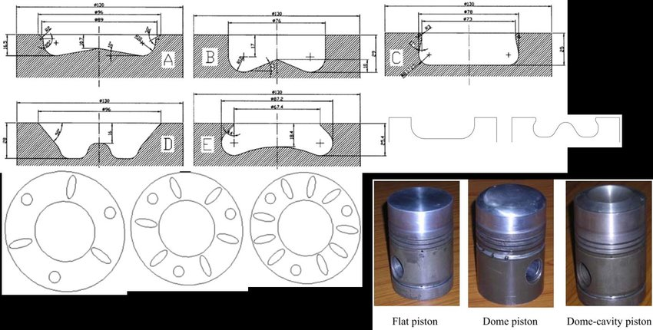
Designing combustion chamber for air flow

Slide 45
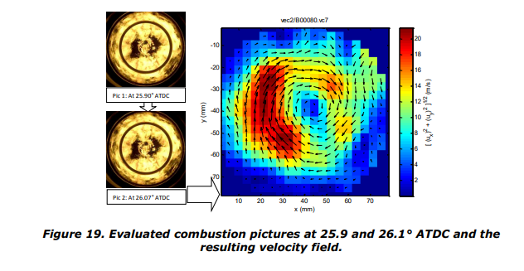
Why airflow is important to combustion

Slide 46
Power Service Products for SA
Diesel Kleen fuel additive + Cetane Boost
Fuel supplement + Cetane Boost
Clear Diesel Tank Cleaner

Slide 47
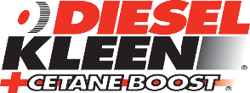
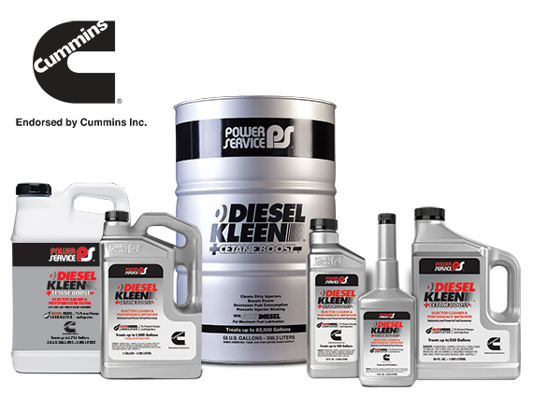

Slide 48
Dosing ratios
Pack size Oz | Ltr | Dosing Ratio
Diesel Kleen & Cetane Boost
12oz | 0.355 | 1; 500
26oz | 0.768 | 1; 500
64oz | 1.893 | 1; 500
Concentrated + Cetane Boost
1 Gal | 3.785 | 1; 1000
Concentrated + Cetane Boost
2.5 Gal | 9.464 | 1; 1500
55 Gal | 208 | 1; 1500
Dosing ratios are critical when calculation cost savings

Slide 49
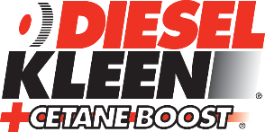
Endorsed by Cummins for use in diesel engines
Exceeds National Conference on Weights and Measures
(NCWM) Premium Diesel Fuel Detergent Specifications
Meets CEC F-98-08 DW10B Clean-Up Detergent Specifications to quickly remove and prevent Internal Diesel Injector Deposits (IDIDs) and restore lost power and fuel economy
Boosts cetane up to 6 numbers — improves combustion so engines run smoother with less power lag and faster cold starts
Boosts power — reduces the need for downshifting
Helps prevent soot loading
Prevents asphaltene formations and thermal breakdown of diesel fuel — protects against sludge formations that plug fuel-filters and injectors

Slide 50
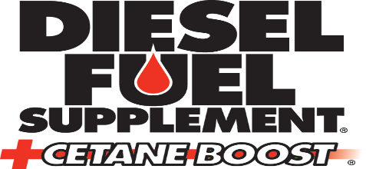
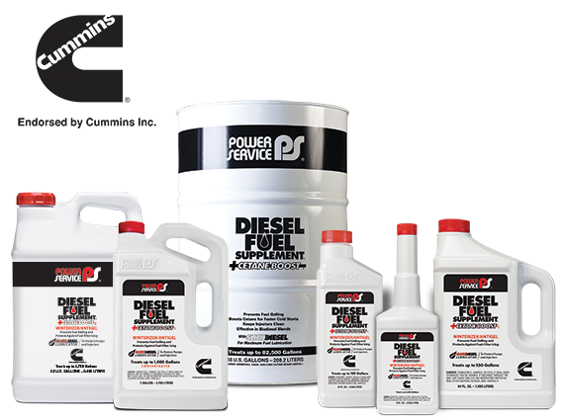

Slide 51
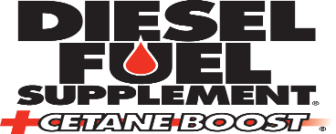
Endorsed by Cummins for use in diesel engines
Effective in lowering the fuel’s Cold-Filter Plugging Point (CFPP) f
Modifies the size and shape of wax crystals to protect against fuel-filter plugging
Lowers the fuel’s Pour Point (PP) to prevent fuel gelling and provide optimal flow at cold temperatures
Contains anti-icing additive — protects against fuel-filter plugging caused by excess moisture in fuels
Exceeds National Conference on Weights and Measures (NCWM) Diesel Fuel Detergent Specifications
Meets CEC F-98-08 DW10B Keep-Clean Detergent Specifications to quickly remove and prevent Internal Diesel Injector Deposits (IDIDs) and restore lost power and fuel economy
Boosts cetane up to 2 numbers — improves combustion so engines run smoother with less power lag
Improves the filterability of asphaltenes and monoglycerides found in diesel fuel as measured by the Filter Blocking Tendency (FBT) test ASTM D2068 — helps prevent fuel-filter plugging
Protects against fuel system corrosion — provides a rating of (A) in NACE Corrosion Testing
Contains Slickdiesel® Lubricator to protect fuel pumps and injectors from increased wear caused by poor quality Ultra Low Sulfur Diesel (ULSD) fuel
Effective in a broad range of diesel fuels, including biodiesel

Slide 52

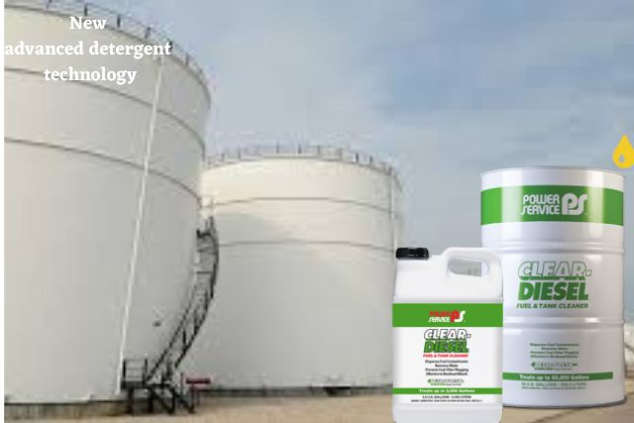

Slide 53

Benefits
Disperses diesel fuel contaminants
Removes water and slime
+Petrofresh® provides maximum long-term storage
stability – keeps fuel fresh
Prevents premature fuel-filter plugging
Protects against fuel tank corrosion
Effective in conjunction with Bio Kleen® Diesel Fuel
Biocide to remove residual water and contaminants
during microbial contamination clean-ups
Effective in all diesel fuels, including Ultra Low Sulfur
Diesel (ULSD) and biodiesel blends
Safe for use in all diesel engines
Will not void engine manufacturer’s warranty when used

Slide 54
.

Slide 55
Why diesel is drying out
https://www.marship.eu/why-diesel-fuel-is-drying-out

Slide 56
Why diesel is drying out
The introduction of lower sulphur levels has brought a huge range of side effects in relation to storage, combustion, ignitions and lubricity of diesel. While most of us are familiar with the microbial problem (Diesel Bug) many underestimate or are unaware of the effects of loss of lubricity.
Why Fuel is Losing Lubricity
It all comes down to the way in which sulphur is removed from diesel. The most cost effective way is to use hydro-processing, during this process the sulphur is removed and replaced by hydrogen; however, hydrogen is a highly reactive element and reacts with other components in the fuel and removes the polar and aromatic compounds that provide conventional diesel fuel with adequate lubricating capability.
Why Lubricity is important
All diesel injection equipment has some reliance on diesel as a lubricant, so it’s easy to understand how important its lubricating properties are, especially for rotary and distributor type fuel injection pumps as found in today’s modern common rail injection systems. In these pumps the moving parts are lubricated by the fuel itself as it moves through the pump rather than the engine oil. Other diesel fuel systems such as injectors, unit injectors, unit pumps and in-line pumps are also partially fuel lubricated. In these systems the mechanism typically consists of a plunger or needle operating in a sleeve or bore, the fuel is used to lubricate the walls between the reciprocating piece and its container. So logically if the fuel loses lubricity there will be an increase in the amount of wear or scarring that will occur between two metal parts requiring fuel lubrication as they come into contact with each other. Low lubricity fuel may cause higher wear and scarring thereby shortening the component life.
We know that without lube oil a diesel engine will grind itself to a premature death, we can now say the same about fuel components.

Slide 57
Cummins press release links
https://www.cummins.com/news/releases/2017/05/10/cummins-inc-officially-recommends-power-service-diesel-kleen-cetane-and
https://www.cummins.com/news/releases/2017/05/10/cummins-inc-officially-recommends-power-service-diesel-kleen-cetane-and
https://www.bearoil.com/news-blog/entry/cummins-and-power-service#:~:text=The%20Power%20Service%20Diesel%20Fuel,to%20customers%20in%20the%20field.%E2%80%9D&text=Diesel%20Kleen%20%2BCetane%20Boost%20%2D%20Endorsed%20by%20Cummins%20Inc.
https://www.firehouse.com/apparatus/components/press-release/12335263/cummins-endorses-power-service-products
This link below is a video tour of the US factory.
https://witherspoon.app.box.com/s/7egl6spx41mkw3hdmkz2tymdahbq7qe1/file/783216823602

Slide 58
Why diesel is drying out
The issue is considered serious, so much so that the International Council on Combustion Engines ( CIMAC ) have set up a subgroup to advise on how best to deal with engines running on low sulphur fuel. In their document ‘Guideline for the operation of marine engines on low-sulphur fuel’ they highlight lubricity as one of the most important issues to consider and state that lubricity characteristics can be restored using lubricity improving additives. Also according to FOBAS from Lloyds Register, fuel with less than 0.05% is dry and they also strongly recommend lubricity is added. We have seen fuel analysis reports showing sulphur at 0.03% – the lowest the tests can report on, so worryingly the actual sulphur content could be even lower.
Approaching the issue Intelligently
So here at Marship, being fuel specialists we started working with one of the biggest global chemical additive manufacturers who supply the world’s largest oil companies. Our aim was to go beyond the standard ‘catch-all’ additive where typically you find yourself paying excessive amounts for a ‘package’ of additives that you don’t need. Instead we have tried to take a more intelligent approach by producing additives aimed at addressing specific fuel problems.
Many vessels only need a lubricity additive, hence the introduction of DieselAid L. This is the right place to start for responsible fuel management. It is true that with today’s modern common rail engines and extremely fine tolerances there is also the issue of gumming and trumpets forming on nozzles, this is when deposit control needs to be considered. Watch out for our next article that talks about this very issue..

